Slide 2
Linear Model
“Endogeneity”
Jan,2015

Slide 3
Endogeneity
Omitted Variables

Slide 4
Definition
Endogeneity is said to occur in a multiple regression model if
$$E (X_{j}u) ≠ 0, for some j = 1, …, k$$
Endogeneity exists if explanatory variables are correlated with the error term.
In general the problem of “endogeneity” refers to anytime there is a violation of the following assumption
$$Cov(Xi,ui) = 0$$

Slide 5
We have two kinds of variables:
Endogenous variables : $cov\left(X ,u\right)≠0$
Exogenous variables : $cov(X,u)=0$

Slide 6
There are at least three generally recognized sources of endogeneity .
(1) Model misspecification or Omitted Variables.
(2) Measurement Error.
(3) Simultaneity.
$$X_{1}$$
Y
X
Y
e
$$X_{2}$$
u
v
X
Y

Slide 7
Omitted Variables
In this note we focus on the problem of omitted variables. Suppose that in the true linear model ,
y = $β_{0}+β_{1}x_{1}+β_{2}x_{2}+u$
we simply do not have data for ${\text{x}}_{2}$. So instead we estimate the following
y = $β_{0}+β_{1}x_{1}+v$

Slide 8
Example 1
Y is earnings, $X_{1}$ is education, and $X_{2}$
is “work ethic” – we don’t observe a person’s work ethic in the data , so we can’t include it in the regression model.
we omit the variable $X_{2}$ from our model.

Slide 9
Does it mess up our estimates of β0 and β1?
It definitely messes up our interpretation of β1. With X2 in the model , β1 measures the marginal effect of X1 on Y holding X2 constant. We can’t hold X2 constant if it’s not in the model.

Slide 10
Continue
Our estimated regression coefficients may be biased
The estimated β1 thus measures the marginal effect of X1 on Y without holding X2 constant. Since X2 is in the error term, the error term will covary with X1 if X2 covaries with X1 .

Slide 11
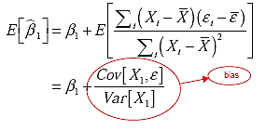
In general, we say that a variable X is endogenous if it is correlated with the model error term. Endogeneity always induces bias.

Slide 12
Solution for the endogeneity omitted variable
Instrumental variables
Proxy variables

Slide 13
Instrumental variables
The IV method involves finding another variable, called an instrumental variable (denoted Z) , which satisfies two properties :
Relevance = Correlated with $X_{1}$ Cov(Z, $X_{1}$) ≠ 0
Exogenous = Not correlated with Y but through its correlation with $X_{1}$ Cov(Z ,u) = 0
Z
$$X_{1}$$
Y
u
$$X_{2}$$

Slide 14
example

Slide 15
Consider an omitted-variable example:
where we omitted ability.
It is easy to find variables that are correlated with edu , for example, mother’s education attainment, family income. But it is difficult to argue for the case that these are not related with ability.

Slide 16
Two-Stage Least Squares (2SLS or TSLS)
The Two-Stage Least Squares (2SLS) method of IV estimation helps to illustrate how the IV approach overcomes the endogeneity problem.
In 2SLS , the parameters are estimated in two stages:

Slide 17
Stage 1:
The endogenous variable ($X_{1}$) is regressed against all of the exogenous variables ( Z)
Stage 2:
The predicted values of $X_{1}$ from the first stage are then used as a regressor in the original equation (as a replacement for $X_{1}$). [Thus all the variables in the second stage will be exogenous]

Slide 18
Properties of the IV estimator
The IV estimator is biased in small samples, but consistent in large samples.
All such IV estimators are consistent, not all are asymptotically efficient. The greater the correlation between the endogenous variable and its instrumental variable, the more efficient the IV estimator.

Slide 19
Important point about IV
Not all of the available variation in X is used
Only that portion of X which is “explained” by Z is used to explain Y
X
Y
X = Endogenous variable
Y = Response variable
Z = Instrumental variable
Z

Slide 20
Important point about IV
X
Y
Best-case scenario: A lot of X is explained by Z, and most of the overlap between X and Y is accounted for
Z
X
Y
Realistic scenario: Very little of X is explained by Z, or what is explained does not overlap much with Y
Z

Slide 21
Remark
Often times there will exist more than one exogenous variable that can serve as an instrumental variable for an endogenous variable. In this case, you can do one of two things.
Use as your instrumental variable the exogenous variable that is most highly correlated with the endogenous variable.
Use as your instrumental variable
the linear combination of candidate exogenous variables most highly correlated with the endogenous variable.

Slide 22
Multiple Regression IV
Write the structural model as
y₁ = b₀ + b₁y₂ + b₂z₁ + u₁,
where y₂ is endogenous and z₁ is exogenous
Let z₂ be the instrument, so Cov(z₂,u₁) = 0 and
y₂ = p₀ + p₁z₁ + p₂z₂ + v₂, where p₂ ≠ 0
This reduced form equation regresses the endogenous variable on all exogenous ones

Slide 23
Best Instrument
Here we’re assuming that both z₂ and z₃ are valid instruments .
The best instrument is a linear combination of all of the exogenous variables, y₂* = p₀ + p₁z₁ + p₂z₂ + p₃z₃
We can estimate y₂* by regressing y₂ on z₁, z₂ and z₃ – can call this the first stage
If then substitute ŷ₂ for y₂ in the structural model, get same coefficient as IV

Slide 24
Proxy variable
Suppose we have a model
where variable${X^{∗}}_{3}$ is unobservable. But suppose that we have another variable ($X_{3}$) which we can use as a proxy for ${X^{∗}}_{3}$.

Slide 25
What properties must $X_{3}$ have?
$X_{3}$must be related to ${X^{∗}}_{3}$.
When $X_{3}$ is plugged into the structural equation, then it must be the case that:
i.Errors are uncorrelated with with $x_{1}$, $x_{2}$, $x_{3}$
ii.v is uncorrelated with $x_{1}$, $x_{2}$ and $x_{3}$. Assuming that v is uncorrelated with $x_{1}$ and $x_{2}$ requires $x_{3}$ to be a “good proxy” for ${X^{∗}}_{3}$. i.e.

Slide 26
example
Consider the equation regression
Assume that
where, E(r ) = 0 and cov (r, IQ) = 0;
moreover we assume that r is uncorrelated with all the other regressors

Slide 27
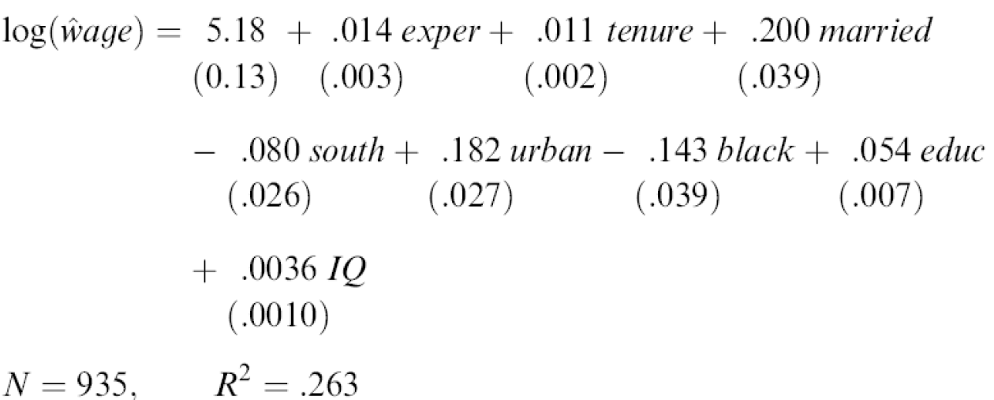
including IQ

Slide 28
Endogeneity
Testing for Endogeneity

Slide 29
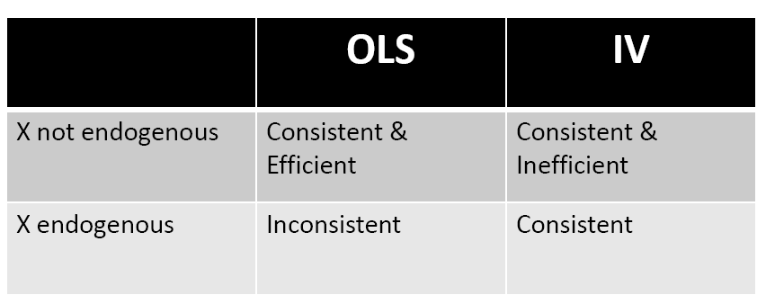
Testing for endogeneity
We can use the facts from the following table to form a test for endogeneity :

Slide 30
Hausman Test
Since OLS is preferred to IV if we do not have an endogeneity problem, then we’d like to be able to test for endogeneity.
If we do not have endogeneity, both OLS and IV are consistent. Idea of “Hausman test” is to see if the estimates from OLS and IV are different .

Slide 31
Hausman test (I)
$H_{0}$: cov(e,x) = 0 $≡$ (hence $β_{IV}$ and $β_{OLS}$ are similar)
$H_{1}$: cov(e,x) ≠ 0 $≡$ (hence $β_{IV}$ and $β_{OLS}$ are different)
Test statistic:
where k is the number of regressors in the model.

Slide 32
Hausman test (II)
While it’s a good idea to see if IV and OLS have different implications, it’s easier to use a regression test for endogeneity.
If $y_{2}$ is endogenous, then $v_{2}$ (from the reduced form equation) and $u_{1}$ from the structural model will be correlated.

Slide 33
Hausman test
Save the residuals from the first stage
Include the residual in the structural equation (which of course has y₂ in it)
If the coefficient on the residual is statistically different from zero, reject the null of exogeneity.
If multiple endogenous variables, jointly test the residuals from each first stage

Slide 34
References
A Symmetric Relationship Between Proxy and Instrumental Variables
Damien Sheehan-Connor,September 9, 2010
ENDOGENEITY SOURCE: OMITTED VARIABLES ,ECON 398B,A. JOSEPH GUSE
The Classical Model,Multicollinearity and Endogeneity
Dealing With Endogeneity,Junhui Qian,December , 2013
Instrumental Variables & 2SLS,Economics 20 - Prof. Anderson
Instrumental Variables Estimation ,(with Examples from Criminology) ,Robert Apel

Slide 35
THanks a lot!
Have a nice day!

